Slide 1
Labor Data Interactive Visualization using Plotly and Dash
Kevin Obuya

Slide 2
Agenda
Individual Background
Methodology
Data Selection and Processing
Results
Findings / Insights
Recommendations

Slide 3
Individual Background
I am enrolled in an MSc. Program in the University of Nairobi, Computer Science Department.
I work as a software developer at present, and are keen on transiting to the data science/machine learning scene.
I have been exploring various visualization tools/techniques, and are very much exited to share with you my latest find: Plotly-Dash

Slide 4
Methodology
Having received the data set and instructions from the hackathon coordinator, I first of all read and understood what the assignment required.
Given my existing strength with visualization solutions such as tableau and PowerBI, and the hackathon specification to show prowess in programming, I chose to use Python’s plotly library for the visualizations, and Dash for the interactive dashboard.
Initial data preprocessing and exploration was primarily done in MS Excel, and after careful consideration, columns of interest were selected
A sketch of the final solution was drafted, before visualization begun(sketches in next page)

Slide 5
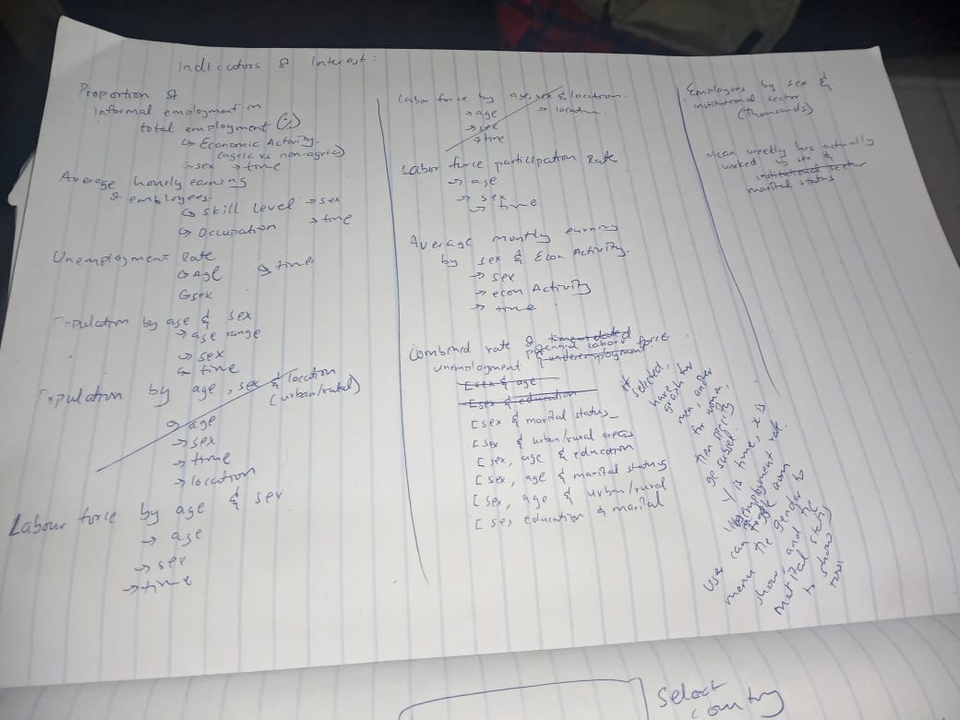
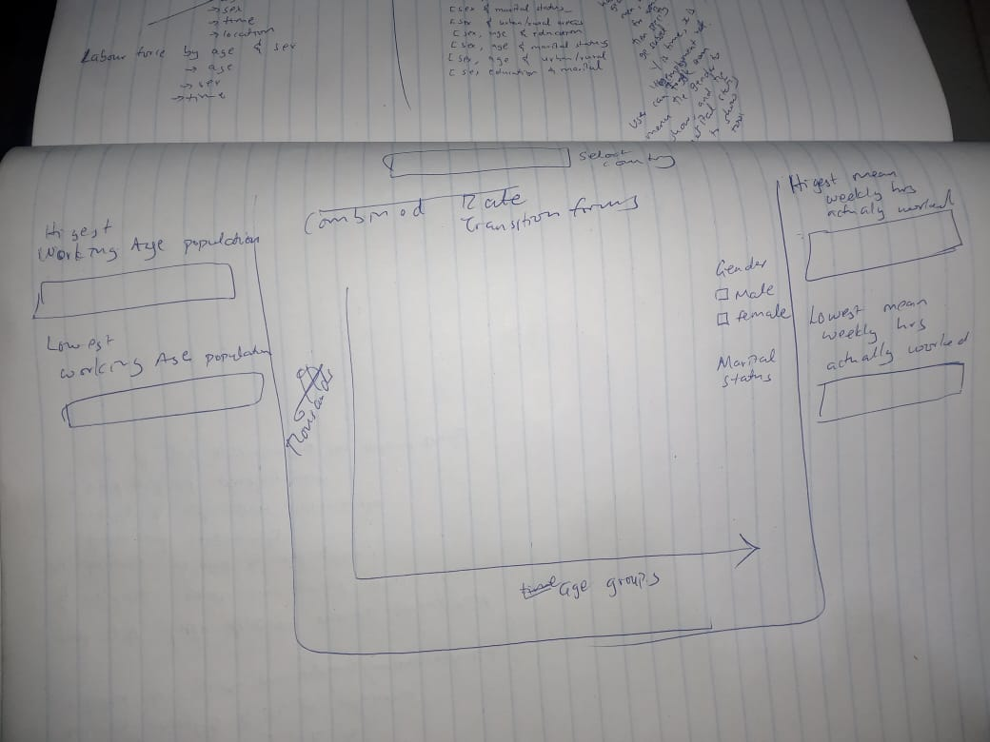
Sketches of Data Selection, and Proposed Visualization

Slide 6
Data Selection and Processing
My data selection was inspired in part by a study conducted by David Ong in early 2022, Is Women’s Competitiveness Expressed Through Their Husband’s Income?
I saw this dataset as an opportunity to either prove or disapprove his findings. However, since the dataset dis not have any explicit data on spouses, and since the recommended population size was restricted to youths, a compromise was reached in which transitions(between schools, between jobs,) are tracked across different age groups (15-19, 20-24, 25-29).
It was hoped that the visualizations will give insight on how employment transitions affect marriage life, across both the sexes
Education Level of The unemployed was also investigated, to determine if education level has an effect on unemployment rate

Slide 7
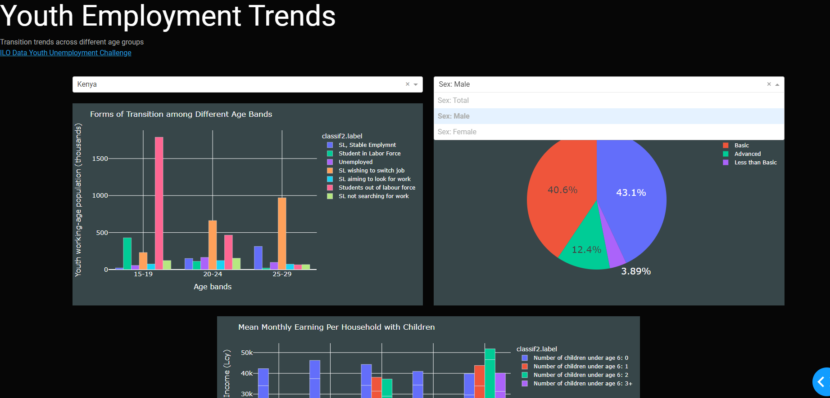
Results
The Project’s Code is hosted in the public Github Repo: kevin-411/iloHackathon (github.com)
Below is a snippet of the dashboard

Slide 8
Findings/Results
Youths that have higher education levels have a higher probability of being unemployed than youths with basic and less than basic education
The number of female school leavers not searching for jobs far exceeds that of male school leavers across the different youth age bands
A lone female youth lone parent earns almost the same mean monthly income as a woman in a couple household with children, while for men, those in couple households tend to have a higher mean monthly income

Slide 9
Recommendations/gaps
Youth ought to be sensitized on the options that are available to them after graduation, and even given proper guidance when choosing degrees to study.
Women should be encouraged to be more proactive with their quest for employment. Women empowerment movements ought to encourage women not to give up on self economic empowerment

Slide 10
Thank you
Kevin Obuya
Kevin.obuya@students.uonbi.ac.ke

